Slide 1
Knowledge-Based and Expert Systems
By Umme Aeman

Slide 2
Knowledge
What is knowledge?
Knowledge is the sort of information that people use to solve problems.

Slide 3
Knowledge-based system (KBS)
A Knowledge-Based System (KBS) is an AI system that uses stored knowledge and logical reasoning to solve complex problems similar to a human expert.
A system which is built around a knowledge base. i.e. a collection of knowledge, taken from a human, and stored in such a way that the system can reason with it.
It is designed to:
Store expert knowledge
Apply reasoning techniques
Provide decisions or recommendations

Slide 4
Knowledge-based Systems (KBS)
A Knowledge-Based (KB) agent in AI is an intelligent system that uses a curated repository of facts and domain-specific rules (the Knowledge Base) combined with an inference engine to reason, make decisions, and take actions.
Unlike data-driven models, KB agents explicitly store knowledge, allowing for transparent, reliable, and logical decision-making.
A Knowledge-Based System (KBS) is an AI system that uses stored knowledge and reasoning techniques to solve complex problems in a specific domain.
It mimics the decision-making ability of a human expert.
Example:
Medical diagnosis system
Expert system for crop disease detection
Financial advisory system

Slide 5
Knowledge-based Systems (KBS)
A Knowledge-Based Agent is an AI system that uses an explicit Knowledge Base (KB) made up of facts and rules to analyze situations, derive conclusions and answers queries or take appropriate actions.
Instead of reacting directly to input, a knowledge-based agent reasons about what it knows, updates beliefs when new information arrives and explains its decisions.

Slide 6
Knowledge-based agent
A Knowledge-Based Agent is an intelligent agent that uses a knowledge base and reasoning to decide what actions to take.
Instead of reacting blindly, it stores knowledge, reasons about it, and then acts.
A Knowledge-Based Agent is an AI system that uses an explicit Knowledge Base (KB) made up of facts and rules to analyze situations, derive conclusions and answers queries or take appropriate actions.
Instead of reacting directly to input, a knowledge-based agent reasons about what it knows, updates beliefs when new information arrives and explains its decisions.

Slide 7
Why Do We Need KBS?
Traditional programs:
Follow fixed algorithms
Cannot reason beyond coded steps
Knowledge-Based Systems:
Can draw conclusions
Can explain decisions
Can simulate expert thinking

Slide 8
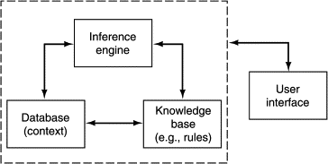
Structure of knowledge-based systems.
5

Slide 9
Knowledge-based Systems
A knowledge-based system in general consists of four main components: a database, a knowledge base, an inference engine, and a user interface.
A user interacts with the system through the user interface. The interaction usually takes the form of query-and-response.
The knowledge base usually contains a set of if–then rules.
The database contains the current data (also called context) of a query–response process.
The inference engine is the reasoning mechanism; it manipulates the if–then rules and the context to produce a response.
For a rule in the form of “If A then B,” A is referred to as the antecedent and B the consequent. Intuitively, A and B represent the condition and action of a rule, respectively.

Slide 10
Main KBS components
Knowledge base
The Knowledge Base is the heart of the system.
Contains essential information about the problem domain
Often represented as facts and rules
Stores domain knowledge
Contains facts and rules

Slide 11
Facts
Information about the problem domain.
Example:
Temperature = 39°C
Patient has cough
Rules
Logical IF–THEN statements.
Example:
IF temperature > 37°C THEN fever
IF fever AND cough THEN flu

Slide 12
Main KBS components
Inference engine
The Inference Engine is the brain of the system.
Mechanism to derive new knowledge from the knowledge base and the Information provided by the user
Often based on the use of rules
Takes input from user
Displays results
Applies reasoning methods
Uses logical rules
Generates new facts

Slide 13
Main KBS components
User interface
Interaction with end users
Development and maintenance of the knowledge base
Takes input from user
Displays results

Slide 14
Main Reasoning Methods
1. Forward Chaining (Data-Driven)
Forward chaining is a data-driven, bottom-up inference method used in knowledge-based systems (KBS) and expert systems. It begins with available data (facts) and repeatedly applies inference rules (usually IF-THEN rules) to extract more data until a specific goal is reached or no more inferences can be made. It is widely used in AI for tasks that involve moving from initial conditions toward a potential conclusion, such as in diagnostic or monitoring applications.
Starts with known facts
Applies rules
Reaches conclusion
Example:
Fact: fever + cough → Rule applied → Conclusion: flu

Slide 15
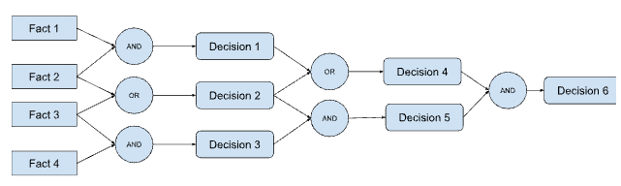
Facts → Rule 1 → Rule 2 → Rule 3 → Conclusion
Data → Intermediate Fact → Final Decision

Slide 16
Knowledge Base
Facts: Leaf color = Yellow, Growth = Slow
Rules: Rule 1: IF leaf color = Yellow THEN chlorosis
Rule 2: IF chlorosis AND growth = Slow THEN nitrogen deficiency
Rule 3: IF nitrogen deficiency THEN recommend nitrogen fertilizer
Forward Chaining Steps
Step 1: Initial Facts Leaf color = Yellow Growth = Slow
Step 2: Apply Rule 1 Leaf color = Yellow, Therefore → chlorosis, New fact added: chlorosis
Step 3: Apply Rule 2 chlorosis AND growth = Slow, Therefore → nitrogen deficiency, New fact added: nitrogen deficiency
Step 4: Apply Rule 3 nitrogen deficiency, Therefore → recommend nitrogen fertilizer
Final Conclusion: The crop has nitrogen deficiency. Recommendation: Apply nitrogen fertilizer.

Slide 17
Main Reasoning Methods
2. Backward Chaining (Goal-Driven):
Backward chaining is a goal-driven, top-down inference technique used in knowledge-based systems (KBS) and expert systems to derive conclusions by working backward from a goal to supporting facts. It starts with a specific query or hypothesis and recursively breaks it down into sub-goals, searching for rules whose conclusions (Then clauses) match the goal, and verifying if their premises (If clauses) are supported by the known data.
Starts with goal
Checks if facts support it
Example:
Goal: Does patient have flu? Check: fever? cough?

Slide 18
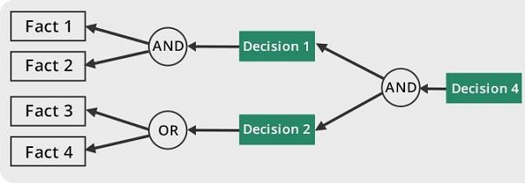
Goal → Check Rule → Check Conditions → Verify Facts → Confirm Goal

Slide 19
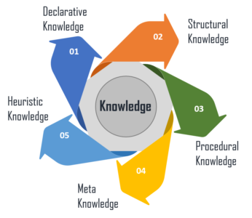
Types Of Knowledge

Slide 20
Types Of Knowledge In AI
1. Declarative Knowledge (Descriptive Knowledge):
Declarative knowledge consists of facts and information about the world that AI systems store and retrieve when needed. It represents "what" is known rather than "how" to do something. This type of knowledge is often stored in structured formats like databases, ontologies, and knowledge graphs.
For example, a fact such as "Paris is the capital of France" is declarative knowledge. AI applications like search engines and virtual assistants use this type of knowledge to answer factual queries and provide relevant information.
Water boils at 100°C.
Rice needs water for proper growth.
A student must have 50% marks for admission

Slide 21
Types Of Knowledge In AI
2. Procedural Knowledge (How-To Knowledge):
Procedural knowledge defines the steps or methods required to perform specific tasks. It represents "how" to accomplish something rather than just stating a fact.
For instance, knowing how to solve a quadratic equation or how to drive a car falls under procedural knowledge. AI systems, such as expert systems and robotics, utilize procedural knowledge to execute tasks that require sequences of actions. This type of knowledge is often encoded in rule-based systems, decision trees, and machine learning models.
Steps to solve a math problem.
Procedure to apply for university admission.
How to diagnose crop disease.
Algorithm for sorting numbers

Slide 22
Types Of Knowledge In AI
3. Meta-Knowledge (Knowledge About Knowledge):
Refers to knowledge about how information is structured, used, and validated. It helps AI determine the reliability, relevance, and applicability of knowledge in different scenarios.
For example, an AI system deciding whether a piece of medical advice comes from a trusted scientific source or a random blog post is using meta-knowledge. This type of knowledge is crucial in AI models for filtering misinformation, optimizing learning strategies, and improving decision-making.
Which rule should be applied first?
When to use forward chaining instead of backward chaining?
Which diagnostic test is more reliable?

Slide 23
Types Of Knowledge In AI
4. Heuristic Knowledge (Experience-Based Knowledge):
Heuristic knowledge is derived from experience, intuition, and trial-and-error methods. It allows AI systems to make educated guesses or approximate solutions when exact answers are difficult to compute.
For example, a navigation system suggesting an alternate route based on past traffic patterns is applying heuristic knowledge. AI search algorithms, such as A* search and genetic algorithms, leverage heuristics to optimize problem-solving processes, making decisions more efficient in real-world scenarios.
If rice leaves turn yellow, it is likely nitrogen deficiency.
If a patient has fever and cough, it is probably flu.
If a car does not start and battery is old, battery may be weak.

Slide 24
Knowledge Representation In AI
Knowledge Representation (KR) in Artificial Intelligence is the method used to store and organize knowledge so that a computer system can understand, reason, and make decisions.
In simple words:
Knowledge Representation = How we represent knowledge in a form that a computer can process.
It allows AI systems to:
Store facts
Represent relationships
Apply reasoning
Solve problems intelligently

Slide 25
Techniques Of KR
1. Logical Representation
Knowledge is represented using formal logic.
Types:
Propositional Logic
First-Order Logic
Example (Propositional Logic): If it is raining → ground is wet
Example (First-Order Logic): All humans are mortal Ali is human Therefore, Ali is mortal

Slide 26
Propositional Logic Represents knowledge as declarative statements (propositions) linked by logical operators like AND, OR, and NOT. For example,
𝒑 → 𝒒
If you have the flu, then you will miss the final examination.
𝒒 → ¬𝒓
If you miss the final examination, then you will not pass the course.
𝒑 ∨ 𝒒 ∨𝒓
You have the flu, or you miss the final examination, or you pass the course. (At least one of these is true.)

Slide 27
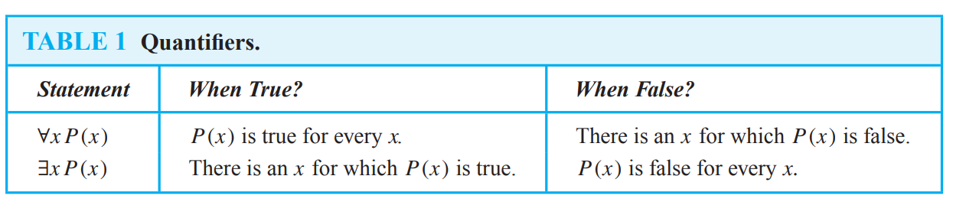
First-Order Logic (FOL) Extends propositional logic by introducing variables, quantifiers, and predicates. FOL can express statements like, “All humans (∀x) are mortal (Mortal(x)).”
A predicate is a sentence that contains a finite number of variables and becomes a statement when specific values are substituted for the variables.

Slide 28
2. Rule-Based Representation (Production Rules)
Knowledge is represented as IF–THEN rules.
Format: IF condition THEN action
Example: IF leaf color = yellow AND growth = slow THEN nitrogen deficiency
Used in:
Expert Systems
Advantages:
Easy to understand
Simple reasoning (forward/backward chaining)

Slide 29
3. Semantic Networks
Knowledge is represented as a graph of nodes and relationships.
Nodes → Objects or concepts
Links → Relationships
Example: Plant —has→ Leaves Rice —is a→ Plant
Advantages:
Easy to visualize
Good for hierarchical knowledge

Slide 30
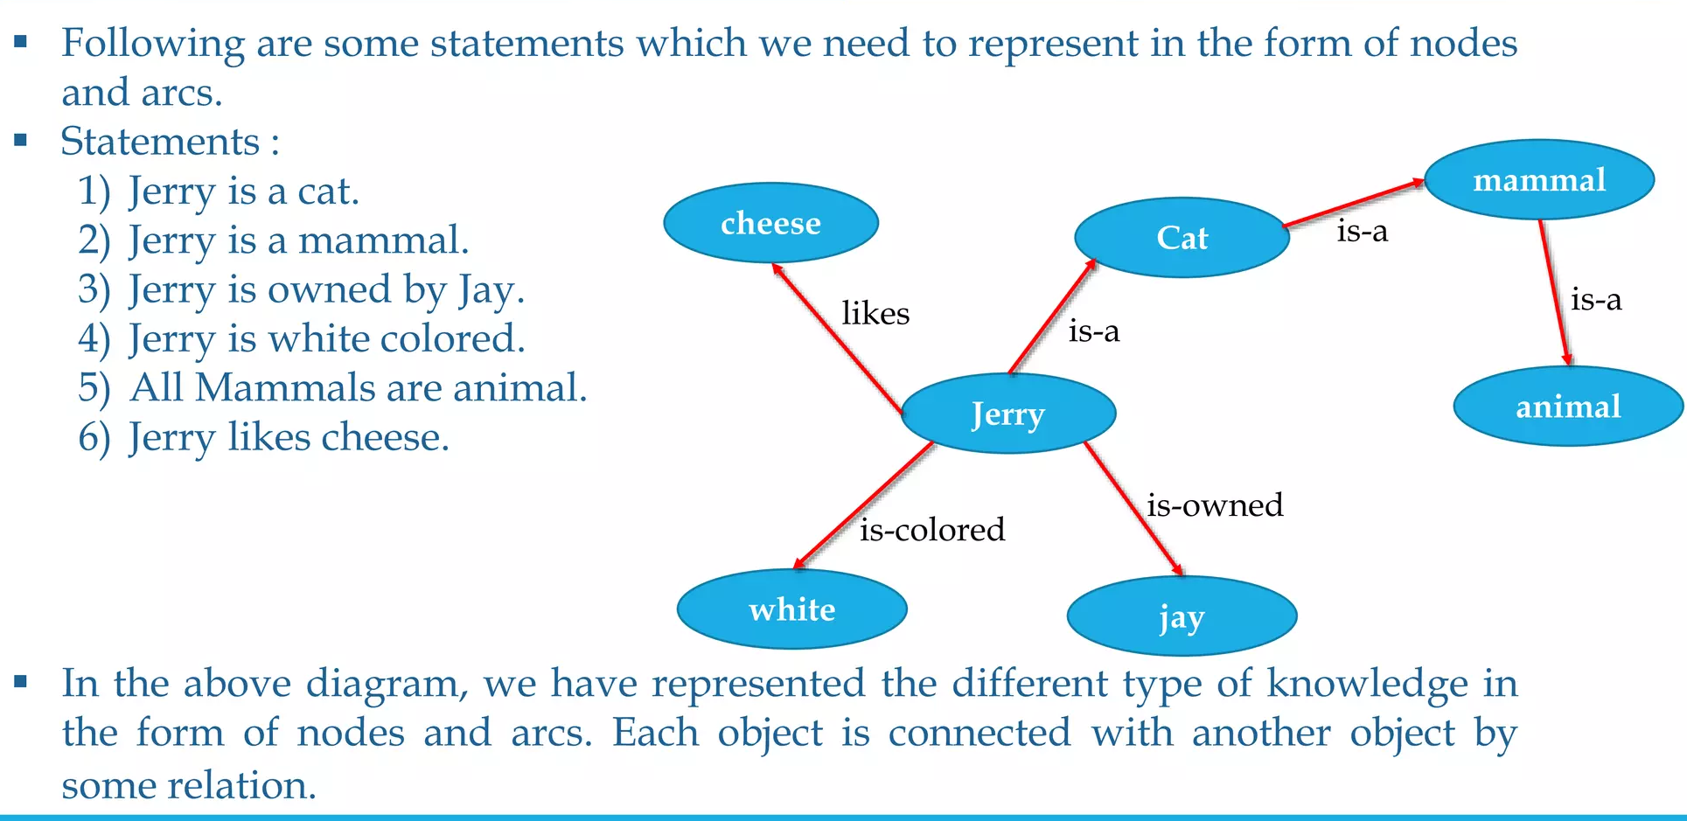

Slide 31
4. Frame Representation
Frames are structured records that describe objects with attributes.
Example:
Frame: Student
Name: Ahmed
Marks: 75%
Department: CS
Frames are like object-oriented structures.
Advantages:
Organized
Good for structured knowledge

Slide 32
Experts
An expert is an experienced practitioner in his/her particular field.
More than that, he/she is a highly effective problem- solver and decision-taker in that field.
Experts have three qualities:
They make good decisions
They make those decisions quickly
They are able to cope with a wide range of problems.
As a result, they are valuable, highly-paid, and tend to be overworked.

Slide 33
Expert System
An Expert System is a type of Artificial Intelligence (AI) program that simulates the decision-making ability of a human expert in a specific domain.
An Expert System is a computer-based system that uses a knowledge base and inference engine to solve problems that normally require human expertise.
It solves complex problems by:
Using stored expert knowledge
Applying logical reasoning
Giving advice, diagnosis, or decisions
It behaves like a human specialist, but in software form.

Slide 34
Advantages Of Expert Systems
Put another way, E.S. have the following advantages over human experts:
The knowledge is permanent
The knowledge is easily replicated
The knowledge is represented explicitly, and can be evaluated
The system is consistent - whereas human practitioners have bad days, computers don’t.
Once built, running costs are low

Slide 35
Disadvantages Of ES
Developing an expert system usually costs a great deal of time and money
Historically, there has been a high failure rate in E.S. Projects
The project may well fail during development - most likely during the “knowledge acquisition” phase.
The development may succeed, but the organization may fail to accept and use the finished system.
A human expert can update his/her knowledge in the light of
Common sense
Knowledge derived from other domain
Contacts with other experts. An expert system can’t.

Slide 36
KBS Advantages
Economical
lower cost per user
Availability
accessible anytime, almost anywhere
Response time
often faster than human experts
Reliability
can be greater than that of human experts
no distraction, fatigue, emotional involvement, …
Explanation
reasoning steps that lead to a particular conclusion
Intellectual property
can’t walk out of the door

Slide 37
KBS Problems
Limited knowledge
“shallow” knowledge
no “deep” understanding of the concepts and their relationships
no “common-sense” knowledge
no knowledge from possibly relevant related domains
“closed world”
the ES knows only what it has been explicitly “told”
it doesn’t know what it doesn’t know
Mechanical reasoning
may not have or select the most appropriate method for a particular problem
some “easy” problems are computationally very expensive
Lack of trust
users may not want to leave critical decisions to machines

Slide 38
Thank You ☺

